Slide 1
User Identification based on Movement
CS6330 Final Project
Dan Olson
Rich Lukas
Robert (George) Burkhardt

Slide 2
User Identification based on Movement
Problem Statement
The Goal of this project was to collect time series data from an IMU, and use it to identify individuals and activities
Movement is highly individualized and unique to each person
Gait is the cyclic movement of the body during locomotion
Gait can be broken down into the Stance phase and Swing phase
Stance Phase Stance Phase
Heel Strike Acceleration Phase
Foot Loading Mid-Swing
Midstance shift Deceleration Phase
Heel-off
Toe-of
Typical methods of analysis consist of stop motion photography, pressure sensors, and accelerometers strapped to the body.

Slide 3
User Identification based on Movement
Methodology
Data Collection
Three test subjects were outfitted with a 6 axis IMU (inertial measurement unit), which recorded angular velocity and acceleration
Data was collected at 500 Hz and then down sampled to 100 Hz
The sensor was mounted at the hip
The recorded activities included
Walking at a measured pace
Running
Stair climbing/descending
Treadmill
Sitting
Jumping
Standing
Data was generated (as opposed to using primary & secondary sets)

Slide 4
Exploratory Data Analysis

Slide 5
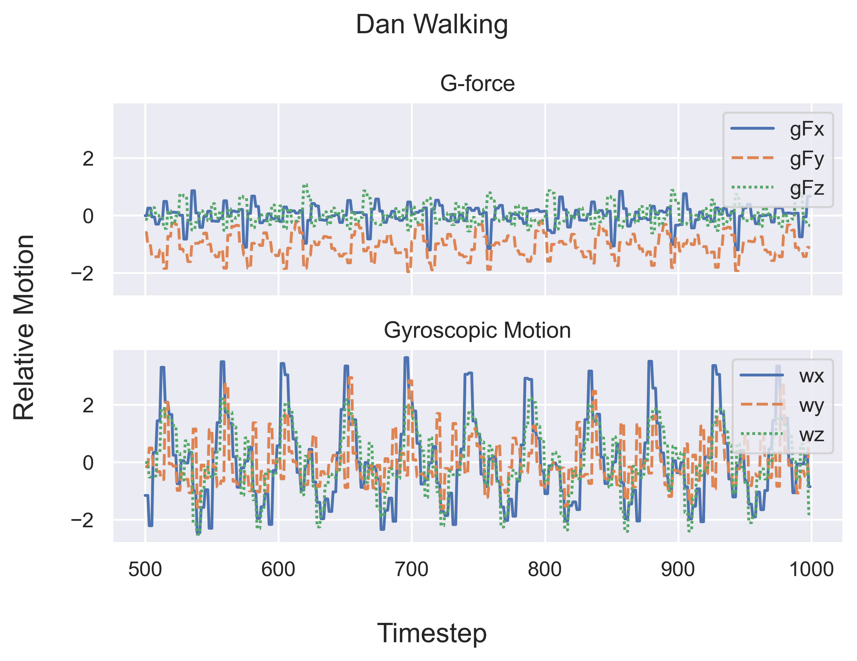
Uniqueness of Gait
Dan Olson

Slide 6
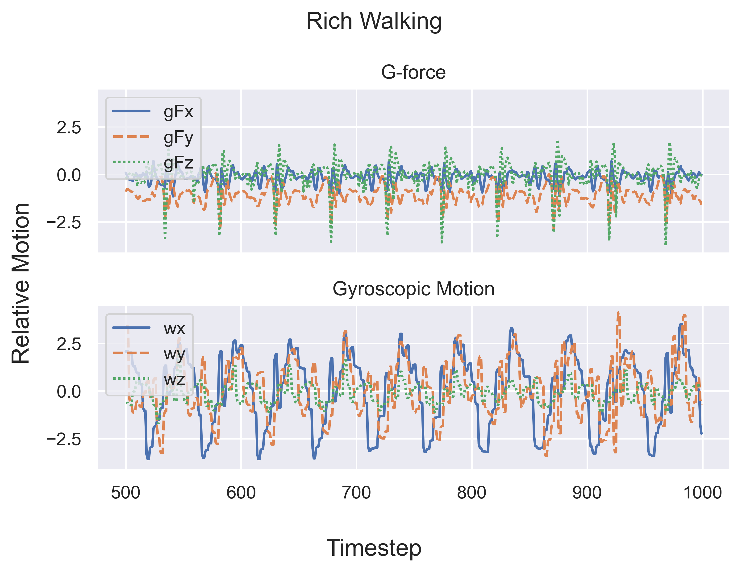
Uniqueness of Gait
Rich Lukas

Slide 7
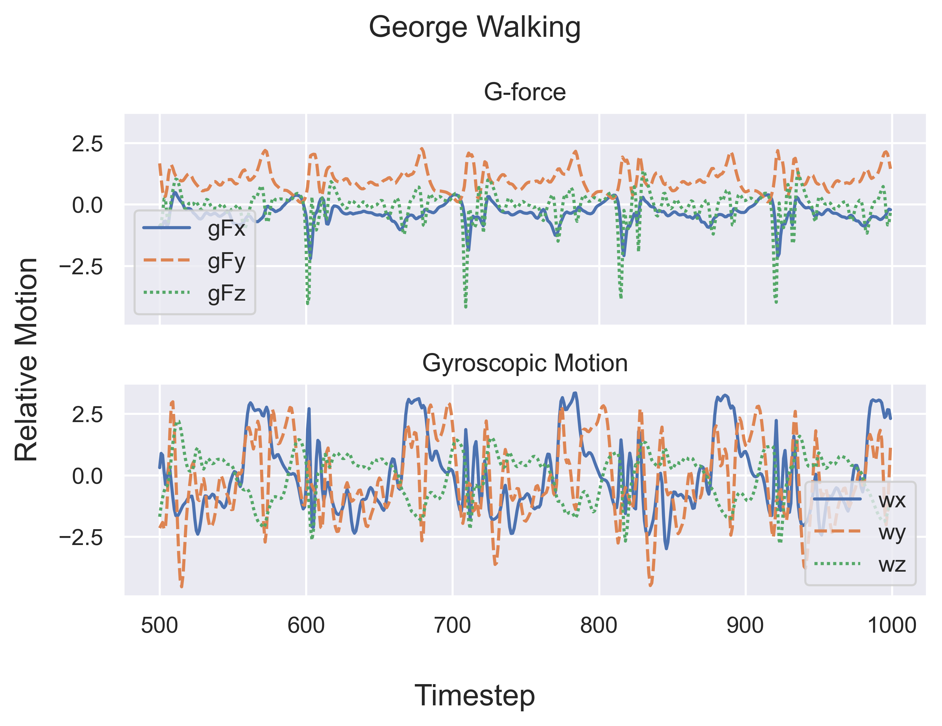
Uniqueness of Gait
George Burkhardt

Slide 8
Uniqueness of Gait Compared
Visualization

Slide 9
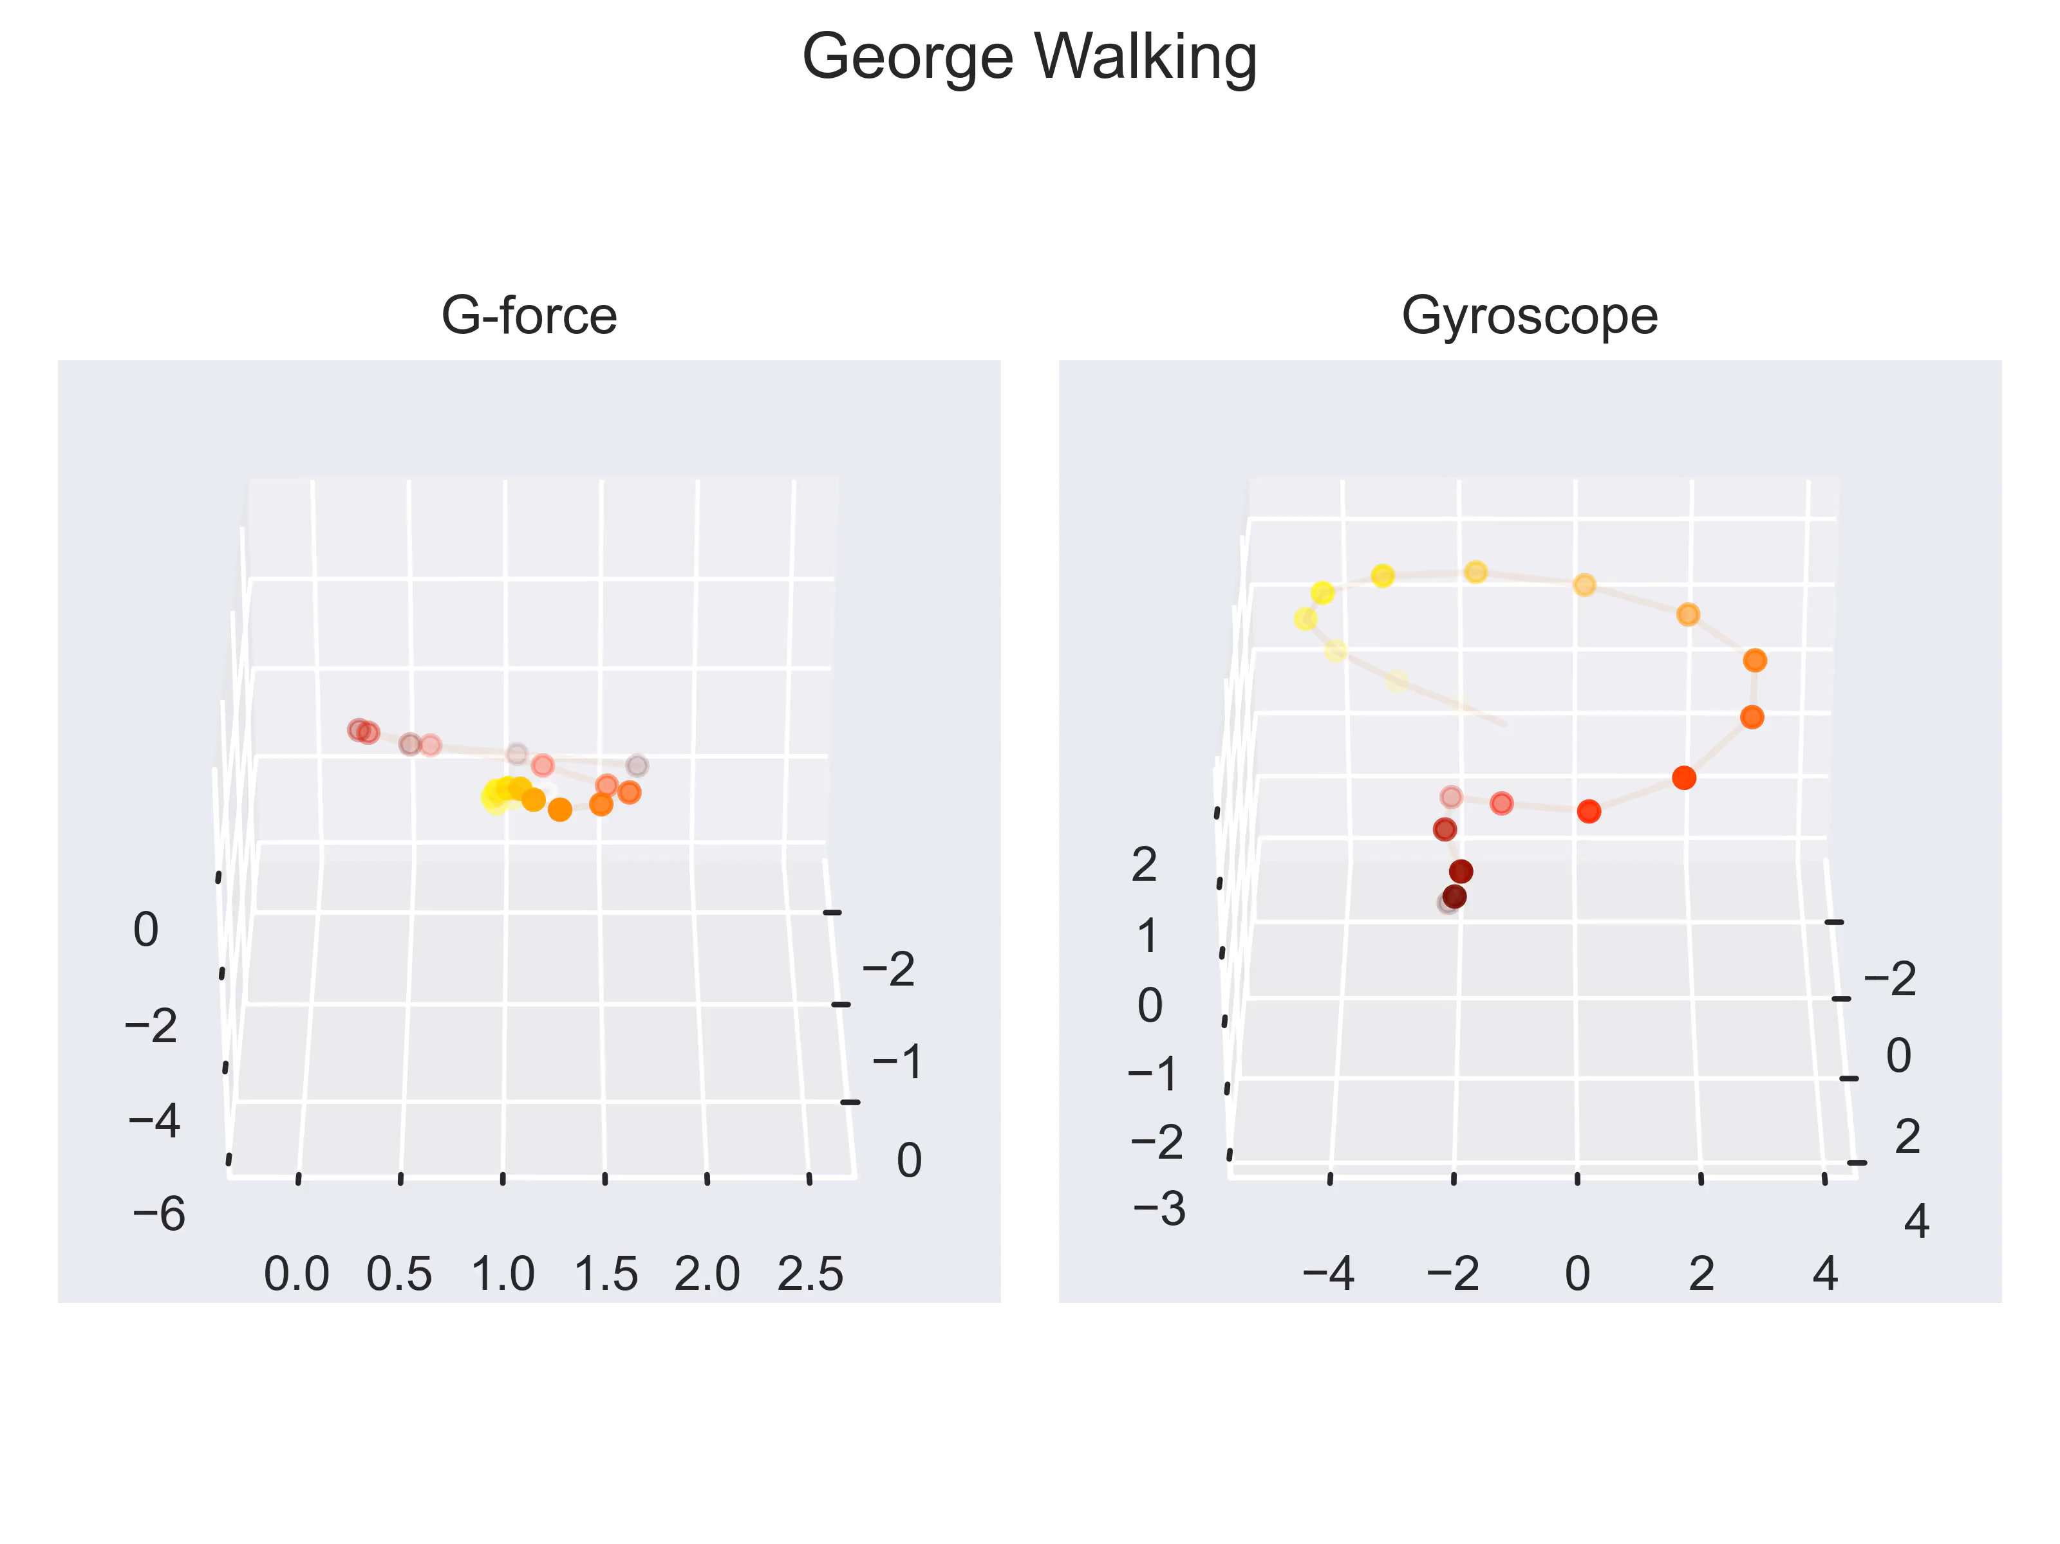
Forces in 3-space
Visualization of Motion

Slide 10
Model the First
Identifying Individuals

Slide 11
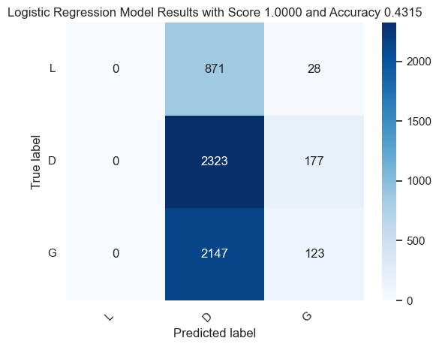
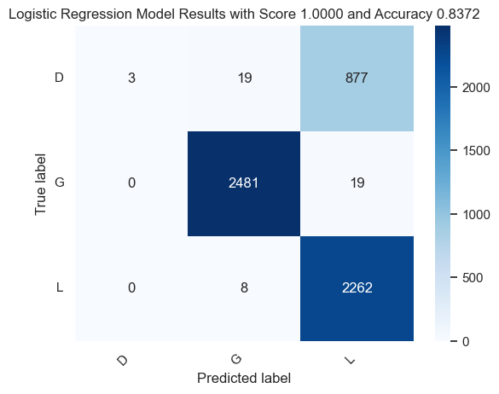
Identifying Individuals
Baseline Model
Identify Individuals
Our baseline model was a Logistic Regression Classifier. We tested a velocity only and acceleration only version
Angular Velocity Only
Angular Acceleration Only

Slide 12
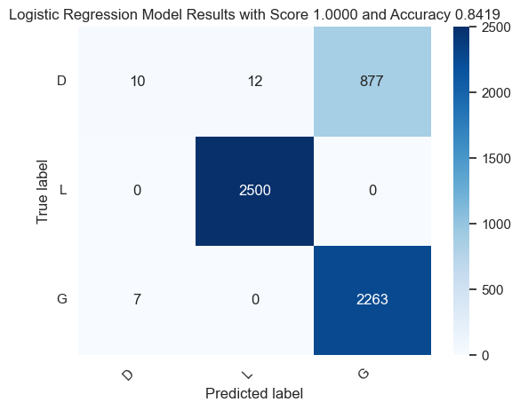
Identifying Individuals
Model Iteration
Improved Model
We then built a model using both angular velocity and acceleration, and applied a low pass filter to smooth the data. The results were slightly better

Slide 13
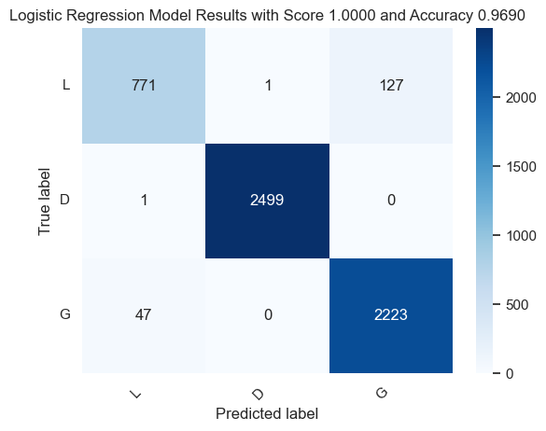
Identifying Individuals
Linear Models
Best Logistic Model
After looking at the outliers, we added an additional EWMA (exponentially weighted moving average) filter with a half-life of 100ms to add more trend data to the model

Slide 14
Identifying Individuals
Linear and Non-Linear Models
Exploring Other Classifier Types
The KNN model did the best, outperforming all other models. All models were built on stratified Train Test data and compared using a separate validation dataset
However, the KNN might not translate well to embedded devices
Model | Balanced Accuracy
Logistic Regression | 0.9688
SVM | 0.9437
Random Forrest | 0.9703
Decision Tree | 0.9611
KNN | 0.9961
MLP | 0.9818

Slide 15
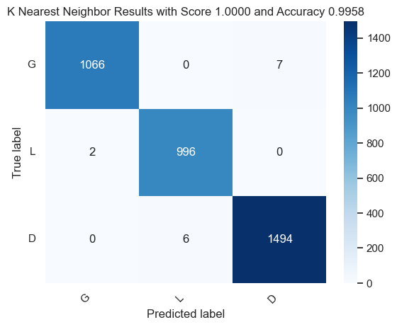
Identifying Individuals
KNN Results
KNN Results

Slide 16
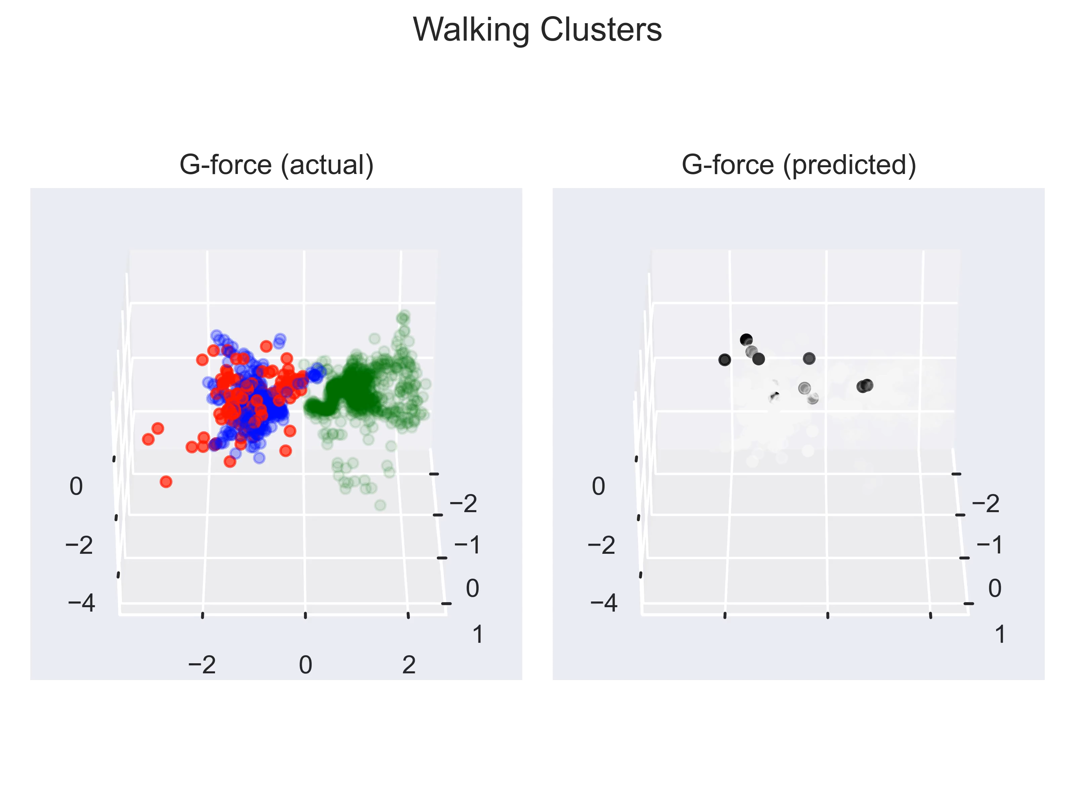
Identifying Individuals
KNN Residuals
KNN Residuals

Slide 17
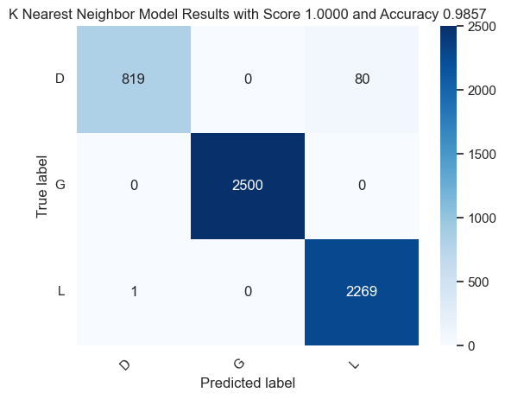
Identifying Individuals
Model Reduction
Reduced Features
To reduce the feature set for user identification, a CART (classification and regression tree) analysis was performed on the Decision Tree Classifier (which had results like the KNN)

Slide 18
Identifying Individuals
Model Reduction
Reduced Features
To reduce the feature set for user identification, a CART (classification and regression tree) analysis was performed on the Decision Tree Classifier (which had results like the KNN)
The CART analysis shows that the exponentially Weighted filtered terms have the greatest significance
Features | Score
gFyE | 0.638
gFxE | 0.212
wzE | 0.076
gFzE | 0.023
wx | 0.014
… | …
Reduced to gFxE, gFyE, and gFzE

Slide 19
Model the Second
Identifying Activities

Slide 20
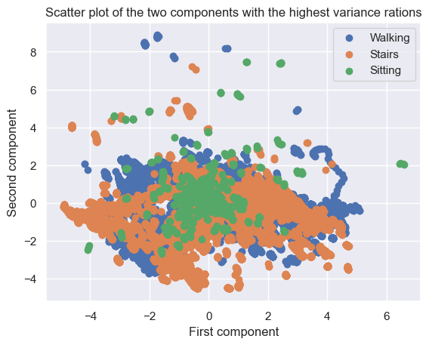
Identifying Activities
Principal Component Analysis
Feature Engineering
Time series data on a variety of activities was collected and labeled. The same feature set as before was used to build classifier models. To help visualize the data a partial correlation analysis was taken to reduce the feature set.

Slide 21
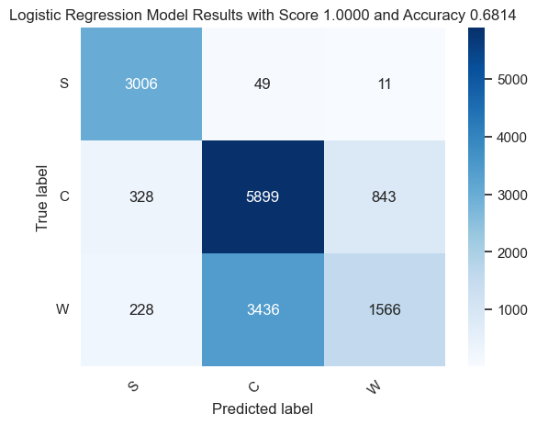
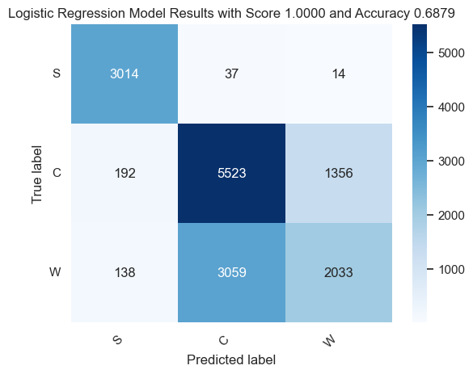
Identifying Activities
Baseline Model
Identify Activities
Following the same procedure as before, we tested a logistic regression classifier model using angular velocity and acceleration. Adding additional features did not significantly improve the results.
Baseline model (angular velocity and acceleration)
Full Model using all 18 features
S (Sitting) C (Climbing) W (Walking)

Slide 22
Identifying Activities
Linear and Non-Linear Models
Exploring Other Classifier Types
The Logistic Model did not seem promising. To resolve this other models were tested
The KNN model did the best, outperforming all other models. All models were built on stratified train-test data, and compared using a separate validation dataset
Model | Balanced Accuracy
Logistic Regression | 0.6857
SVM | 0.6599
Random Forrest | 0.9155
Decision Tree | 0.981
KNN | 0.9943
MLP | 0.9128

Slide 23
Identifying Activities
KNN Results
KNN Results

Slide 24
Identifying Activities
KNN Residuals
KNN Residuals

Slide 25
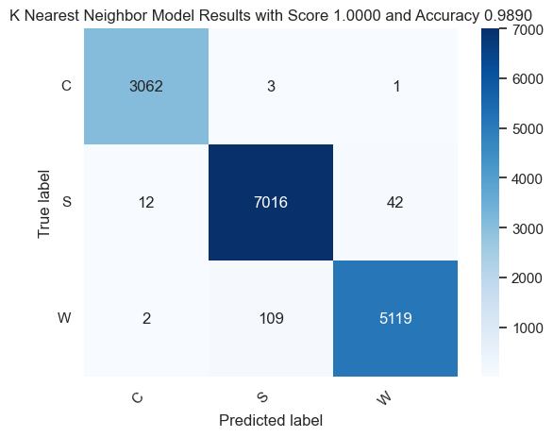
Identifying Individuals
Model Reduction
Reduced Features
A KNN model for activity identification was built using only exponentially filtered term based on the CART analysis. The results were nearly identical to the full model, showing the model reduction is valid.
Features | Score
gFxE | 0.212
gFzE | 0.201
gFyE | 0.168
wxE | 0.08
wyE | 0.044
wzE | 0.04
… | …
Reduced to gFxE, gFyE, gFzE, wxE, wyE, and wzE

Slide 26
Conclusion
Did we succeed?

Slide 27
Identifying Individuals
Linear and Non-Linear Models
Success – but more to do!
Based on our findings, these explorations could be extended further
Identify Speed/Length of Stride
Abnormal locomotion
Handedness
In principle we can build a power tool that identifies its operator using gait biometrics, rather than a user id. This also suggests that a tool could be customized based on how a user is holding the tool (e.g. righty vs lefty)
Reasonable model improvements could involve measuring IMU at several points on the body and using stride length as an additional feature

Slide 28
About Us
Before we go…

Slide 29

About Us
ML-ers Extraordinaire
Rich Lukas
Mgr EE
ML Team, FEI
Big Takeaways
A great deal of information is buried in IMU data. We can infer a great deal about a work site and user behavior.
Greater confidence in our ability to measure/model our environment beyond simply tool performance
Ability to manipulate data in Python, and create sophisticated analysis

Slide 30
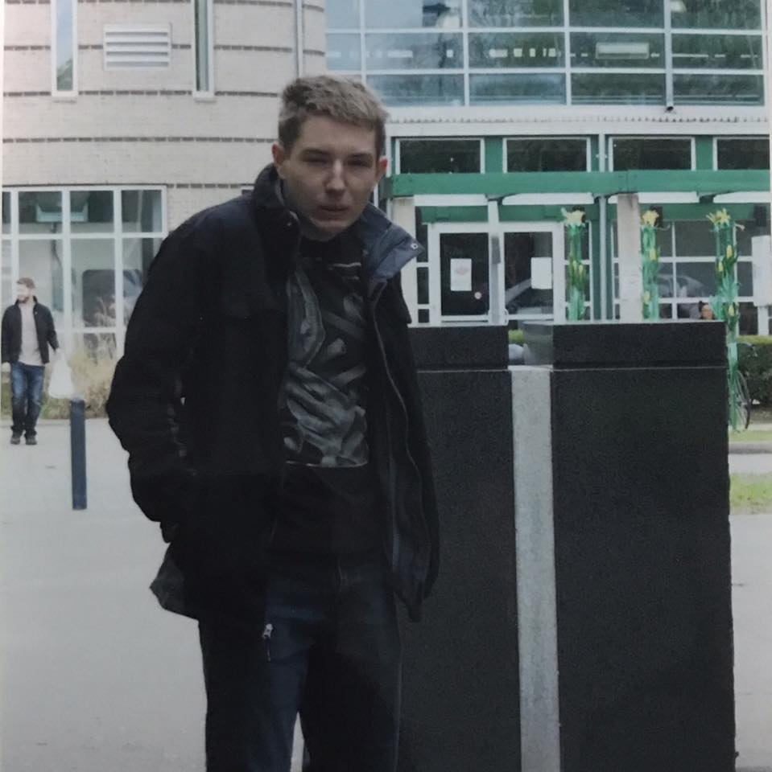
About Us
ML-ers Extraordinaire
George Burkhardt
Senior Software Engineer (Direct Supply)
Big Takeaways
Data is key and king – capturing non-linear/latent signals is hard without good data
Some problems align really well with available libraries, models, and techniques (as was this case)
Time series are scary but Rich makes ‘em look easy
There’s so much more to learn and explore – this is only the beginning!

Slide 31
About Us
ML-ers Extraordinaire
Dan Olson
TBD
Big Takeaways
TBD

Slide 32
Question and Answers

